Slide 1
CS 61A Discussion 2
HOFs and Environment Diagrams
attendance: links.cs61a.org/keon-disc

Slide 2
Agenda
Administrivia
Survey Says...
Review - HOFs
Practice!
Short Break
Review - Environment Diagrams
More Practice!

Slide 3
Administrivia
Project 1 (Hog) is due TONIGHT, 11:59 PM
Homework 2 is due tomorrow,, 11:59 PM
Midterm 1 is next Monday, time and room TBA
HKN Midterm 1 Review is this Saturday 12-3 PM in HP
CSM Midterm 1 Review is this Sunday, 2-4 PM in GPB 100
No lab next week
Checkoffs are changing, will announce later

Slide 4

Survey Says...

Slide 5
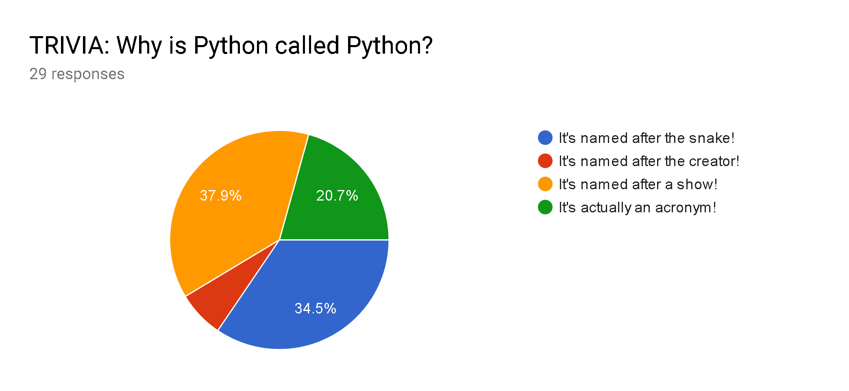
Survey Says...

Slide 6
HOFs

Slide 7
Higher Order Functions
Any function that either:
Takes in a function as an argument or...
Returns a function
Used to pass functions as values, made up of two parts:
Code = all logic, represented by the function name
Parent = wherever it inherits values from

Slide 8
Environment Diagrams
(again)

Slide 9
This Again?
Yes, they’re important! Helps you think about code execution.
Reminders:
Assignments drawn out should first evaluate the right hand side!
Bind the resulting value to the variable name afterwards.
If the value is a primitive expression, write it in a box.
If not, draw an arrow to the value.
Built-in functions don’t need a new frame.

Slide 10
Practice

Slide 11
HOF Problem #1
Write a function that takes in an integer n and returns a function that takes an integer x and returns the value x to the power n.
def powerful(n):
return “”” YOUR CODE HERE “””
>>> powerful(5)(2)
32

Slide 12
HOF Problem #1 - Solution
Write a function that takes in an integer n and returns a function that takes an integer x and returns the value x to the power n.
def powerful(n):
return lambda x: x ** n
>>> powerful(5)(2)
32

Slide 13
HOF Problem #2
Write a function that returns a lambda that takes an integer x and returns a function that takes an integer y; all of which returns the value x to the power y.
def powerful_func():
return “”” YOUR CODE HERE “””
>>> (powerful_func())(2)(5)
32
Notes:
Parentheses?

Slide 14
HOF Problem #2 - Solution
Write a function that returns a lambda that takes an integer x and returns a function that takes an integer y; all of which returns the value x to the power y.
def powerful_func():
return lambda x: lambda y: x ** y
>>> (powerful_func())(2)(5)
32

Slide 15
HOF Problem #3
Draw the environment diagram of the following.
def powerful(n):
print(‘Print statements?’)
return lambda x: x ** n
print(‘hmm’)
print(print(powerful(5)(2))

Slide 16
HOF Problem #3 - Solution
Solution

Slide 17
HOF Problem #4
foo = ‘bar’
def foo(foo):
return bar(foo) + ‘bar’
def bar(foo):
return foo
barfoo = bar(foo)(‘foo’)

Slide 18
HOF Problem #4 - Solution
Solution

Slide 19
Worksheet Practice

Slide 20
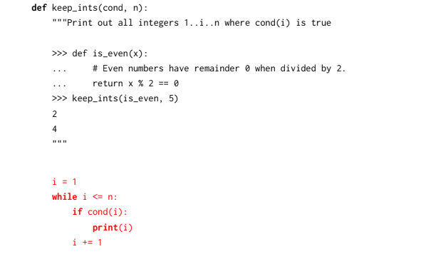

Slide 22
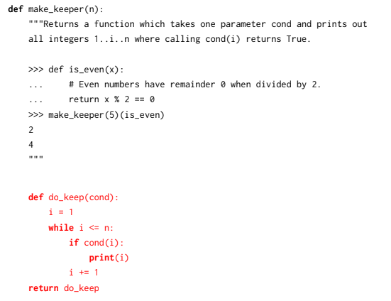

Slide 24
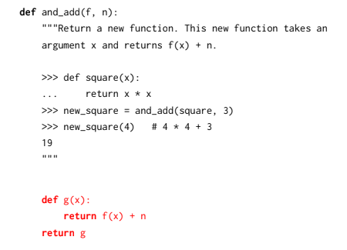

Slide 26
Intermission

Slide 27
Worksheet Practice #2

Slide 28
Section Summary
HOFs are just fancier functions that treat other functions as values.
Environment diagrams are useful for mapping out confusing code!
Don’t stress too much about the midterm. Just remember:
Python executes code left to right, top to bottom
Evaluation is inside out
Primitives are drawn in boxes, everything else has arrows
Lambdas are your friend! Learn them well.

Slide 29
Any questions?
Contact me at keonktsang@berkeley.edu if you think of something later.
ALSO: did you fill out the discussion survey?
links.cs61a.org/keon-disc

